Slide 1
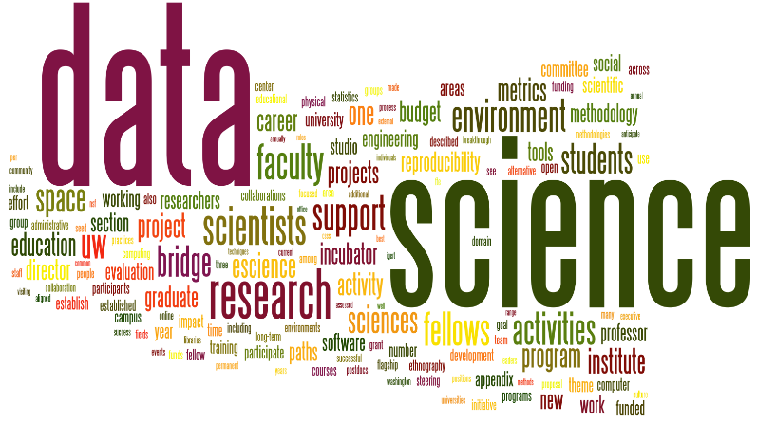
Big Data and Data Analytics
Paul Rad, Ph.D.
Associate Professor
Cyber Analytics and AI
Information Systems and Cyber Security
College of Business School
210.872.7259

Slide 2
Outline
Overview of Python Libraries for Data Scientists
Reading Data from Different Sources
Selecting and Filtering the Data
Plotting the data
Data manipulation, sorting, grouping, rearranging
Descriptive statistics
Inferential statistics

Slide 3
Python Libraries for Data Science
Many popular Python toolboxes/libraries:
NumPy
SciPy
Pandas
SciKit-Learn
Ternsorflow
Visualization libraries
matplotlib
Seaborn

Slide 4
Python Libraries for Data Science
NumPy:
introduces objects for multidimensional arrays and matrices, as well as functions that allow to easily perform advanced mathematical and statistical operations on those objects
provides vectorization of mathematical operations on arrays and matrices which significantly improves the performance
many other python libraries are built on NumPy
Link: http://www.numpy.org/

Slide 5
Python Libraries for Data Science
SciPy:
collection of algorithms for linear algebra, numerical integration, differential equations, optimization, and statistics
built on NumPy
Link: https://www.scipy.org/scipylib/

Slide 6
Python Libraries for Data Science
Pandas:
adds data structures and tools designed to work with table-like data
provides tools for data manipulation: reshaping, merging, sorting, slicing, and aggregation.
allows handling missing data
Link: http://pandas.pydata.org/

Slide 7
Python Libraries for Data Science
SciKit-Learn:
provides machine learning algorithms: classification, regression, clustering, model validation etc.
built on NumPy, SciPy and matplotlib
Link: http://scikit-learn.org/

Slide 8
Python Libraries for Data Science
matplotlib:
python 2D plotting library
line plots, scatter plots, barcharts, histograms, pie charts etc.
relatively low-level; some effort needed to create advanced visualization
Link: https://matplotlib.org/

Slide 9
Python Libraries for Data Science
Seaborn:
based on matplotlib
provides high level interface for drawing attractive statistical graphics
Link: https://seaborn.pydata.org/

Slide 10
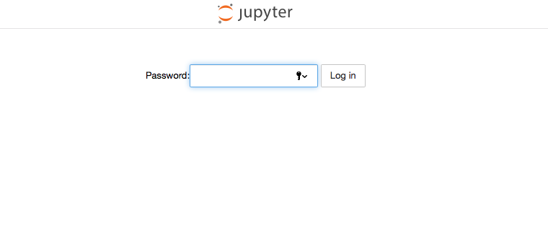
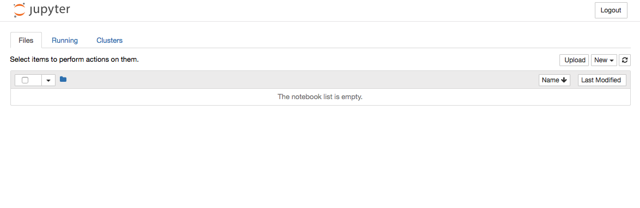
Login to your Cloud Server
Use your machine learning Cloud Server login information
jupyter notebook
Getting Around in iPython Notebook

Slide 11
Download tutorial notebook
Github
https://github.com/utsabigdata/AI-Workshop

Slide 12
Data Analytics Process
Plan a Data Strategy
Acquire Data
Prepare Data
Analyse Data
Present Findings
Take Action
Purchase
Subscribe Collect
Sense
Store
Organize
Extract
Transform
Relate
Enrich
Learn
Curate
Describe
Classify
Discover
Simulate
Predict
Prescribe
Visualize
Report
Engage
Advice
Decide
Act
Affect
Assess

Slide 13
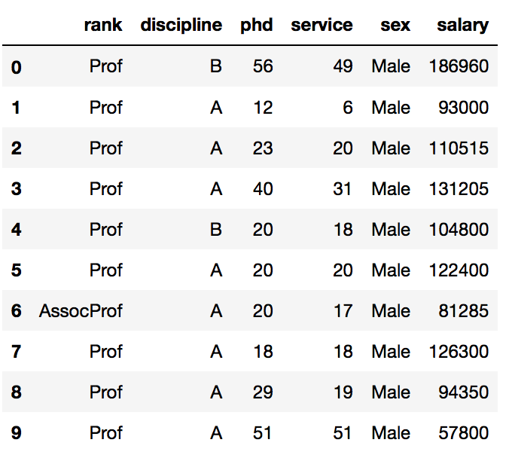
Pandas DataFrame
Pandas DataFrame is two-dimensional, heterogeneous tabular data structure with labeled rows and columns ( axes ).
In [ ]:
import pandas as pd

Slide 14
Importing and Exporting Data
Process of loading and reading data into Python from various resources
Two important properties
Format
Various formats: .csv, json, .xlsx, .hdf
File Path of dataset
https://archive.ics.uci.edu/ml/machine-learning-databases/autos/imports-85.data

Slide 15
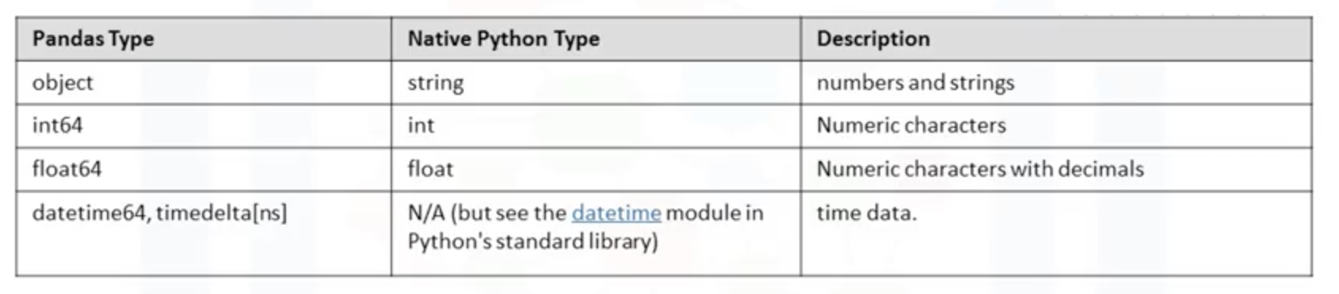
Insights of Dataset – Data Types
Why check data types?
Potential info and type mismatch
Compatibility and python methods

Slide 16
Insights of Dataset – Data Types
In Pandas,
Explore data: df.head()
Check data types: df.dtypes
Statistical summary: df.describe()
Full summary statistics: df.describe( include = “all” )

Slide 17
Data Frame data types
Pandas Type | Native Python Type | Description
object | string | The most general dtype. Will be assigned to your column if column has mixed types (numbers and strings).
int64 | int | Numeric characters. 64 refers to the memory allocated to hold this character.
float64 | float | Numeric characters with decimals. If a column contains numbers and NaNs(see below), pandas will default to float64, in case your missing value has a decimal.
datetime64, timedelta[ns] | N/A (but see the datetime module in Python’s standard library) | Values meant to hold time data. Look into these for time series experiments.

Slide 18
Pandas DataFrame Column Update
access a column:
df[“rank”]
df[“salary”] = df[“salary”] + 1000

Slide 19
Data Frames methods
All attributes and methods can be listed with a dir() function: dir(df)
df.method() | description
head( [n] ), tail( [n] ) | first/last n rows
describe() | generate descriptive statistics (for numeric columns only)
max(), min() | return max/min values for all numeric columns
mean(), median() | return mean/median values for all numeric columns
std() | standard deviation
sample([n]) | returns a random sample of the data frame
dropna() | drop all the records with missing values

Slide 20
Coding Exercise #1

Slide 21
Data Cleaning or Wrangling (pre-processing)
Data preprocessing is an important step in the data mining process.
The phrase "garbage in, garbage out" is particularly applicable to data mining and machine learning projects.
Data-gathering methods are often loosely controlled, resulting in
Out-of-box values (e.g., Income: −100)
Impossible data combinations (e.g., Sex: Male, Pregnant: Yes)
Missing values
Analyzing data that has not been carefully screened for such problems can produce misleading results. Often, data preprocessing is the most important phase of a machine learning project.

Slide 22
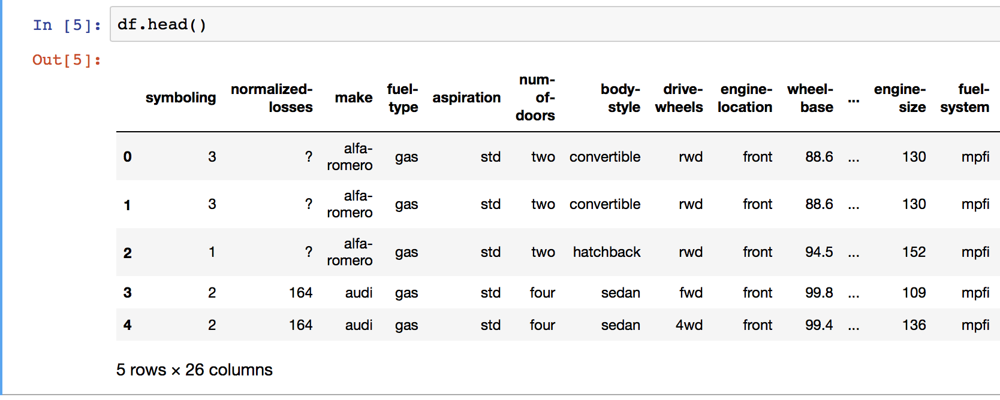
Missing values
- Presented at “?”, “N/A”, 0, or a blank cell
- Drop the missing values
df.dropna()
- Replace the missing values
df.replace(missing_value, new_value):

Slide 23
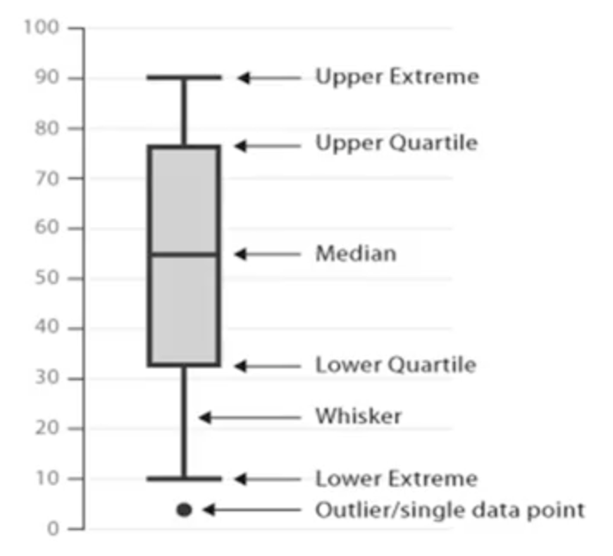
Descriptive Statistics – Describe ()
Summarize statistics using Panda df.describe ()
Summarize categorical data by using the value_counts method
df[“attribute”].values_counts()
Box Plots
75%
25%

Slide 24
Data Formatting in Panda
Data are usually collected from different places and stored in different formats. Bringing data into a common standard of expression allows users to make meaningful comparison.
To identify data types:
Use dataframe.dtypes () to identify data type.
To covert data type
Use dataframe.astype() to convert data type
df[["price"]] = df[["price"]].astype("float")
# cast the column price to a float

Slide 25
Data Normalization in Panda
Not-normalized | Normalized
Different columns (attributes) are in different range | Similar value range
Hard to compare | Equal influence on analytics model
Higher value numbers will influence the results more

Slide 26
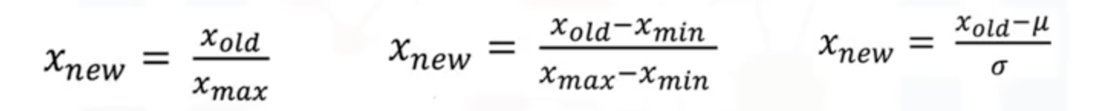
Methods for Data Normalization
Several approached for normalization:
Simple Feature Scaling
Min-Max
Z-score
df[“attribute”] = df[“attribute”]/df[“attribute”].max()
df[“attribute”] = (df[“attribute”] – df[“attribute”].min())/(df[“attribute”].max()-df[“attribute”].min())
df[“attribute”] = (df[“attribute”] - df[“attribute”].mean())/df[“attribute”].std()

Slide 27
Coding Exercise #2

Slide 28
Explore Data
Descriptive Statistics using df.describe()
Categorical data using value_counts()
Correlation corr()
Visualization

Slide 29
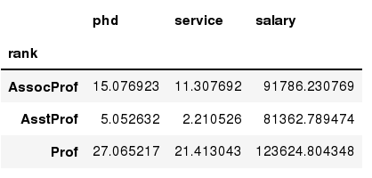
Data Frames groupby method
Using "group by" method we can:
Split the data into groups based on some criteria
Calculate statistics (or apply a function) to each group
In [ ]:
#Group data using rank
df_rank = df.groupby(['rank'])
In [ ]:
#Calculate mean value for each numeric column per each group
df_rank.mean()

Slide 30
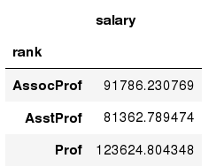
Data Frames groupby method
Once groupby object is create we can calculate various statistics for each group:
In [ ]:
#Calculate mean salary for each professor rank:
df.groupby('rank')[['salary']].mean()
Note: If single brackets are used to specify the column (e.g. salary), then the output is Pandas Series object. When double brackets are used the output is a Data Frame

Slide 31
Data Frame: filtering
To subset the data we can apply Boolean indexing. This indexing is commonly known as a filter. For example if we want to subset the rows in which the salary value is greater than $120K:
#Calculate mean salary for each professor rank:
df_sub = df[ df['salary'] > 120000 ]
In [ ]:
Any Boolean operator can be used to subset the data:
> greater; >= greater or equal;
< less; <= less or equal;
== equal; != not equal;
In [ ]:
#Select only those rows that contain female professors:
df_f = df[ df['sex'] == 'Female' ]

Slide 32
Data Frames: Slicing
When selecting one column, it is possible to use single set of brackets, but the resulting object will be a Series (not a DataFrame):
In [ ]:
#Select column salary:
df['salary']
When we need to select more than one column and/or make the output to be a DataFrame, we should use double brackets:
In [ ]:
#Select column salary:
df[['rank','salary']]

Slide 33
Data Frames: Selecting rows
If we need to select a range of rows, we can specify the range using ":"
In [ ]:
#Select rows by their position:
df[10:20]
Notice that the first row has a position 0, and the last value in the range is omitted:
So for 0:10 range the first 10 rows are returned with the positions starting with 0 and ending with 9

Slide 34
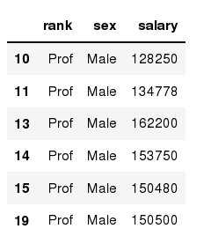
Data Frames: method loc
If we need to select a range of rows, using their labels we can use method loc:
In [ ]:
#Select rows by their labels:
df_sub.loc[10:20,['rank','sex','salary']]
Out[ ]:

Slide 35
Coding Exercise #3

